Slide 1



INFSCI 2160
Lucy Chen
Quinton Steele
Jordan Widjaja
yic76
qjs2
jow105

Slide 2
Background
Recently, there are many conversations surrounding extraterrestrial life and “Area 51” yet little data analysis projects seen with UFO sightings and reports. Are there certain factors that give rise to certain sightings? Are some sightings random or is there a bigger phenomenal leading to them? We are curious to find any patterns and relationship amongst these UFO sightings.
Problem
To discover patterns and relationships between temporally and spatially different reports that might explain a cause for certain UFO sightings.

Slide 3
Type of Problem
Supervised Learning
Prediction of Shape (classification)
Prediction of Region (classification)
Prediction of Duration (regression)
Unsupervised Learning
Clustering similar sightings
Hypothesis
Text decomposition will predict location and UFO shape, since the speaker likely describes it. Regional variance will define clusters.

Slide 4

Data
National UFO Reporting Center
Sources:
Historical reports
Police
Journals/personal writings
NUFORC's own telephone hotline and online reporting system

Slide 5
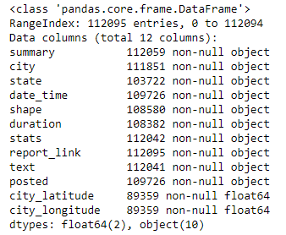
Observations: 112095
Years: 1969 - 2017
Locations: All around the world; mainly the US

Slide 6
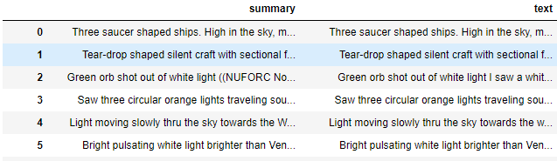
Data Preparation
Summary column
Fill in missing “text” with “summary” and remove summary column

Slide 7
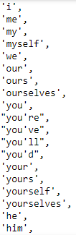

2. Text column
Natural Language Processing
Remove punctuation marks
Remove stopwords
Apply vectorization
TF-IDF (originality of word)

Slide 8


3. Duration column
Determine whether hours, minutes, or seconds are are being referenced
Parse string for numerals and extract
Outputs correspond to the referenced time in seconds

Slide 9
4. Region Column
Based on the state, determine which region either in the United States, Canada, or other country the state corresponds to and create a column that places the location in one of these region buckets:
United States - Pacific, Rockies, Midwest, etc.
Canada - North Canada, Prairie Provinces, British Columbia, etc.
Other Countries

Slide 10
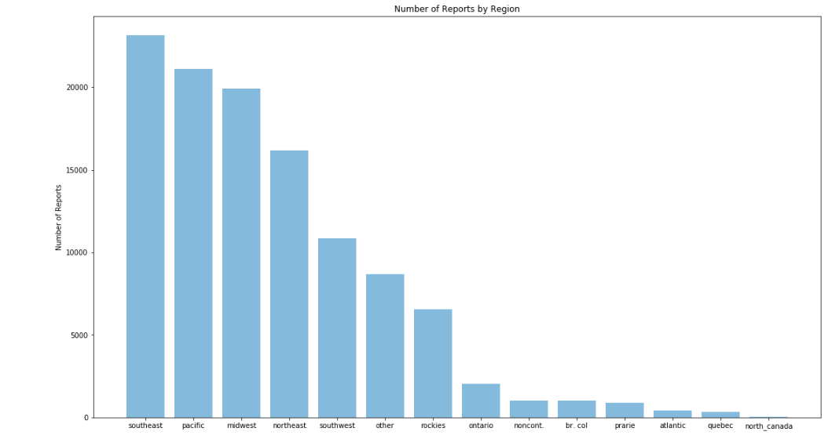
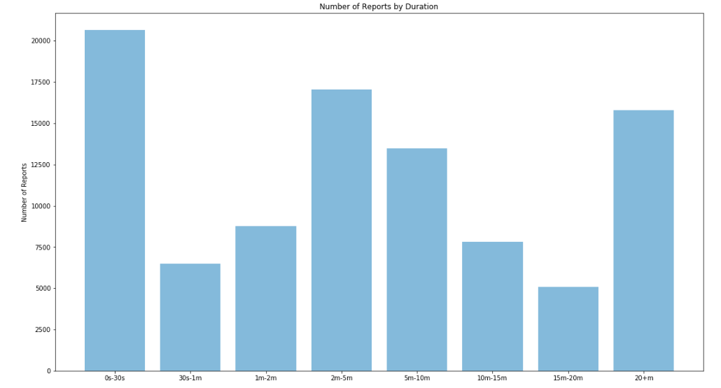
Summary Statistics
Figure 1. Number of reports by region
Figure 2. Number of reports by duration

Slide 12
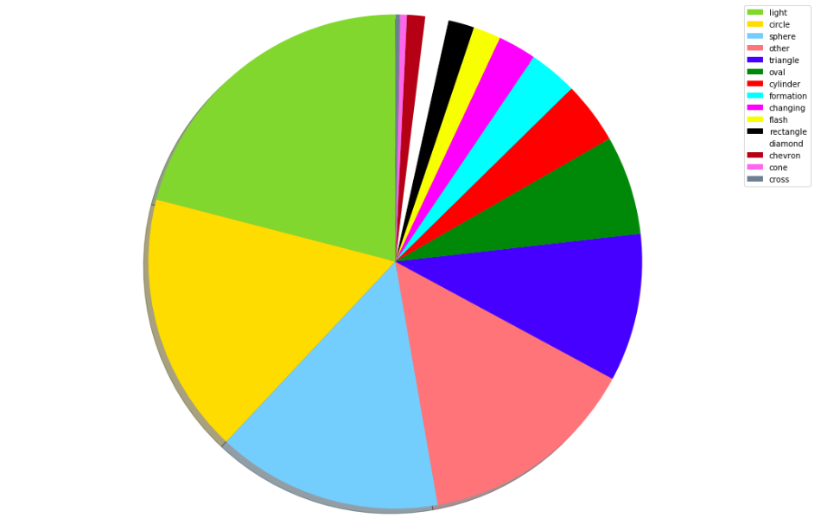
Figure 3. Distribution of number of reports by shape

Slide 13
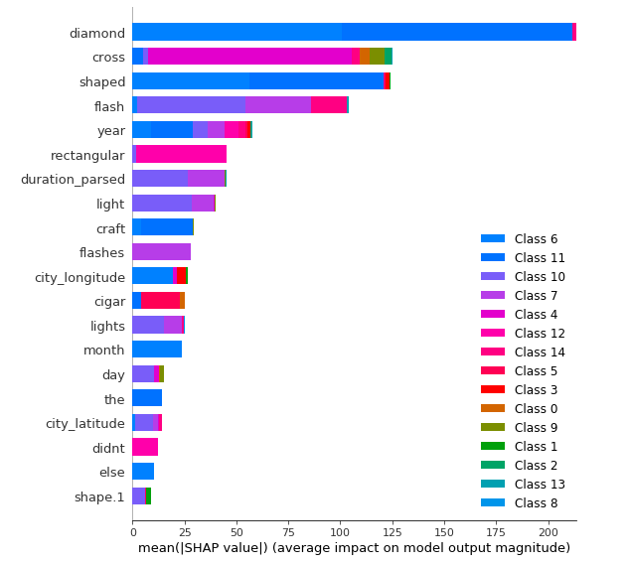
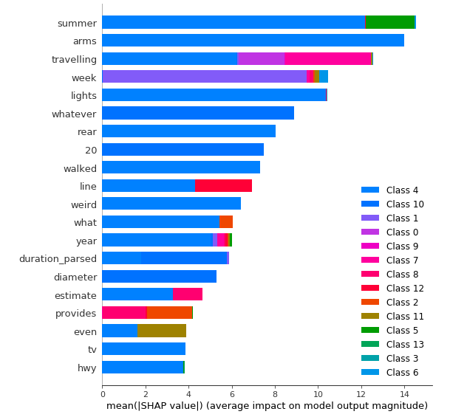
SHAP summary plot for Shape prediction
SHAP summary plot for Region prediction

Slide 14

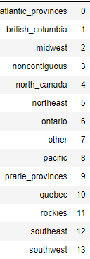

Slide 15
Techniques
Supervised
Models
Naive Bayes
LightGBM
Hyperparameter Tuning
Gridsearch
RandomizedSearchCV
Hyperopt
Unsupervised
K-means
UMAP
DBSCAN

Slide 16

Results
Shape Prediction
Train accuracy: 0.476; Test accuracy: 0.467
Train logloss: 1.947; Test logloss: 2.056
Best hyperparameters:
Region Prediction
Train accuracy: 0.295; Test accuracy: 0.283
Train logloss: 2.189; Test logloss: 2.288
Best hyperparameters:
Duration Prediction
Train R2: -117.965, Test R2: -0.00888
Best hyperparameters:

Slide 17
Conclusion
Shape Prediction
The most significant feature in predicting some shapes is the word of the shape in the text
Aside from the shape words, the ‘years’ feature also has a significant contribution to predicting some of the shapes
Region Prediction
Most significant feature in predicting “North Canada” is the word “Summer”
Duration Prediction
R2 values imply that there is a very low correlation between the features and our results, perhaps even worse than comparing to the mean of all duration values.
Clustering
Patterns in text reporting follow a rural/urban divide
What about our hypotheses?
Our inputs ended up being fairly reliable (for the quality of data) as a predictor for shape and region, but duration prediction is intractible. Other factors than text played an important role
Clustering of texts did not follow regional divisions but seem to follow socioeconomic ones.

Slide 18
Future works
Better computing power to allow more grid search parameters and better evaluation results
Utilizing neural networks for text analysis
Train models temporally to chart evolution of models over large timespan
More thorough data cleaning and cross-reference for fields which can be interpolated

